Slide 1
John Hopkins Middle School
2023-2024
Course Selection

Slide 2
CGS Schedules – 8 Periods
Tasks Today:
1. Determine if you will take PE or if a waiver will be used for task 2.
2. List 3 choices for the 8th class. Rank your choices as 1 for your top request, 2 for second choice, and 3 for third choice.
Minor magnet class
AVID
Spanish 1 or 2 (HS credit)
Digital Information Technology (HS credit)
Introduction to Marketing
CGS Classes x5
Advanced Academics
Language Arts
Math
Science
Social Studies
Main Magnet Focus x2
You will be scheduled in your current main magnet focus for next year.
If you want to change your main magnet focus, please contact Mrs. V.

Slide 3
Magnet Schedules – 8 Periods
Core Classes x4
Language Arts
Math
Science
Social Studies
Main Magnet Focus x2
You will be scheduled in your current main magnet focus for next year.
If you want to change your main magnet focus, please contact Mrs. V.
Intensive Reading if FAST Reading PM 3 score from May’s assessment is level 1 or 2.
Tasks Today:
1. Determine if you will take PE or if a waiver will be used for additional electives (see task 2).
2. List 3 choices for elective choices. Rank your choices as 1 for your top request, 2 for second choice, and 3 for third choice.
Minor magnet class
AVID
Spanish 1 or 2 (HS credit)
Digital Information Technology (HS credit)
Introduction to Marketing

Slide 4
Traditional Schedules – 8 Periods
Core Classes x4
Language Arts
Math
Science
Social Studies
Intensive Reading if FAST Reading PM 3 score from May’s assessment is level 1 or 2.
ESE Scholars with an IEP: Unique Skills Learning and/or Social Emotional.
Tasks Today:
1. Determine if you will take PE or if a waiver will be used for additional electives (see task 2).
2. List 3 choices for elective choices. Rank your choices as 1 for your top request, 2 for second choice, and 3 for third choice.
AVID
Spanish 1 or 2 (HS credit)
Digital Information Technology (HS credit)
Introduction to Marketing
CAB 1 / 2 or 3 / 4
Journalism 1
Understanding Music
Music Technology
Creative Photo/Digital Art & Design
Pre-AP Visual Arts (HS credit)
TA (grade 8, by approval)

Slide 5
Business Technology
Progression of classes towards certification or HS credit:
Computer Applications in Business (CAB 1 and 2) - Grade 6
Computer Applications in Business (CAB 3 and 4)Grades 7 & 8
Introduction to Marketing, Sales, and Service- Grades 7 & 8
Digital Information Technology DIT - Grade 8
This Photo by Unknown author is licensed under CC BY.
Notes:
Wing/Rogers

Slide 6
Computer Applications in Business (CAB1 and CAB2) - Grade 6
Keyboarding
Word processing (Word and Google docs)
Electronic presentation (PowerPoint)
Computer hardware and software
Internet
Spreadsheet (Excel)
Digital citizenship and online safety
Assisting students in making informed decisions regarding their future academic and occupational goals
Instruction and learning activities are provided in a laboratory setting using hands-on experiences. Students earn digital literacy certifications that are reflected on their transcripts.
Notes:
Wing

Slide 7
CAB: Computer Applications in Business 3 and 4 Grades 7 & 8 (Prerequisite work in CAB 1 & 2 (or similar work) required)
What Take This Course?
Learn advanced spreadsheet, intermediate digital design, introductory database and web design skills
Earn industry certifications – GREAT for showcasing foundational computer skills
This Photo by Unknown Author is licensed under CC BY-SA-NC
Notes:
Rogers

Slide 8
Introduction to Marketing, Sales, and Service - Grades 7 & 8
Management and Entrepreneurship
e-Marketing
Professional Sales and Marketing
Marketing Research
Communications and Promotion
Leadership and communication skills
Instruction and learning activities are provided in a laboratory setting using hands-on experiences
Identifying problems and opportunities with an entrepreneurial mindset to acquire crucial life skills such as:
Problem-solving
Teamwork
Empathy
Learning to accept failure as a part of the growth process.
Notes:
Wing

Slide 9
Digital Information Technology DIT: High School Credit Grade 8 (Teacher Recommendation Required)
Why Take This Course?
Earn Fine Arts credit required to graduate high school
Learn proper procedures to create documents, spreadsheets, and presentations for schoolwork
Earn industry certifications – GREAT for resumes and college applications
This Photo by Unknown Author is licensed under CC BY-NC
Notes:
Rogers

Slide 10
AVID Advancement Via Individual Determination
John Hopkins Middle School
AVID’s College and Career Readiness System​
​
​What is AVID?
AVID
(Advancement Via Individual Determination) is a national college preparatory program geared toward 'academic middle' students to give them an academic push to do great things. Students from AVID are 33% more likely to graduate and go to college.
If you are an individual that enjoys a challenging and fun learning environment. ​
​If you ready to make positive decisions that will affect the rest of your life.
If you want to be apart of a program that is designed to support you in being successful in and out of the classroom.
Then AVID might be for you.
Check out the video on the next slide to learn more about this wonderful program.
Notes:
Arnold

Slide 12
Spanish: Spanish
In M/J Spanish Beginning, Spanish 1 and Spanish 2, we will work on all four language skills: Listening, Reading, Speaking and Writing. Second Language Acquisition research (as well as our own experiences in acquiring our first languages) tells us that we need a lot of Input before we can create any Output. How old were you when you started speaking your first language? Could you speak it immediately? Did you speak it perfectly? Of course not!
Acquiring a language takes time! It requires a lot of Comprehensible Input. That means I will be speaking a lot of Spanish in class, but I will keep it simple, speak very slowly, use gestures and body language as clues and repeat high frequency words many, many times to allow the students time to acquire the language. In this course, our goal will be to ACQUIRE Spanish language. “Acquiring” a language is very different than “learning” a language. Acquiring is something that happens to you instead of something that you make happen. When you learned how to speak your first language, you acquired it naturally by listening to other people speak it around you for a long time; not by studying it.
Notes:
Rissler

Slide 13
Beginning Spanish Grades 6 or 7
Students will be able to:
Demonstrate understanding of basic words, phrases, and questions about self and others.
Ask simple questions and provide simple responses related to self and others.
Understand and use in context common concepts (such as numbers, actions, days of the week, etc.) in simple situations.
Present personal information about self and others.
Recognize basic products, practices and/or perspectives of culture where the target language is spoken.
Modules-Units:
Unit 1-Q1 Identitad y Relaciones (Identity & Relationships)
Unit 2 –Q2 Mi Mundo Personal (My Personal World)
Unit 3-Q3 Ciudadanía Mundial (Global Citizenship)
Unit 4-Q4 Mi Familia y mis Valores (My Family and my Values)
Notes:
Rissler

Slide 14
Spanish 1
Credit:
Spanish 1 is a full-year, high school credit class. The final grade students earn in this class will be used to calculate high school rank and the students’ high school GPA.
Modules-Units:
Unit 1-Q1 Dice
Unit 2 -Q1 El encierro de Fermín
Unit 3-Q2 Cierra la puerta
Unit 4-Q2 Mi escuela, mi futuro
Unit 5-Q3 Siéntate
Unit 7-Q4 Los Castells de Tarragona
Unit 8-Q4 Búscalo
Unit 8-Q4 El Cucuy
Notes:
Rissler

Slide 15
Spanish 2
*Must have taken Spanish 1.
Credit:
Spanish 2 is a full-year, high school credit class. The final grade students earn in this class will be used to calculate high school rank and the students’ high school GPA.
Modules-Units:
Unit 1-Q1 La comida y Emociones
Unit 2 -Q1 Deportes
Unit 3-Q1 El Cortejo
Unit 4-Q2 Niños prisioneros
Unit 5-Q2 Gauchos
Unit 7-Q2 Guerra Sucia
Unit 8-Q3 Sorteo de Navidad
Unit 8-Q3 El Viajero
Unit 9-Q3 Biblioburro
Unit 10- Q4 Ladrones
Unit 11-Q4 Aventura de Camping
Unit 12 -Q4 Tres Cerditos.
Notes:
Rissler

Slide 16
Visual Arts 1 (suffix A) Grade 6
Let your creative side shine!
Learn and build upon foundational art skills
Explore:
Painting
Drawing
Clay
Sculpture
Printmaking
Digital collage
Notes:
Schilling
All access elective, separate section (suffix A) from magnet (suffix F).

Slide 17
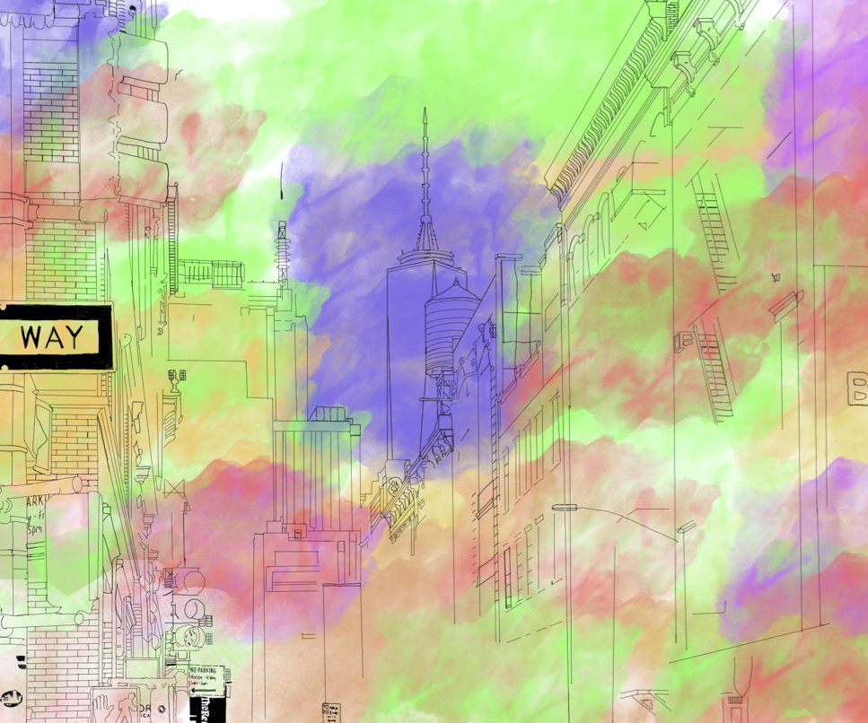
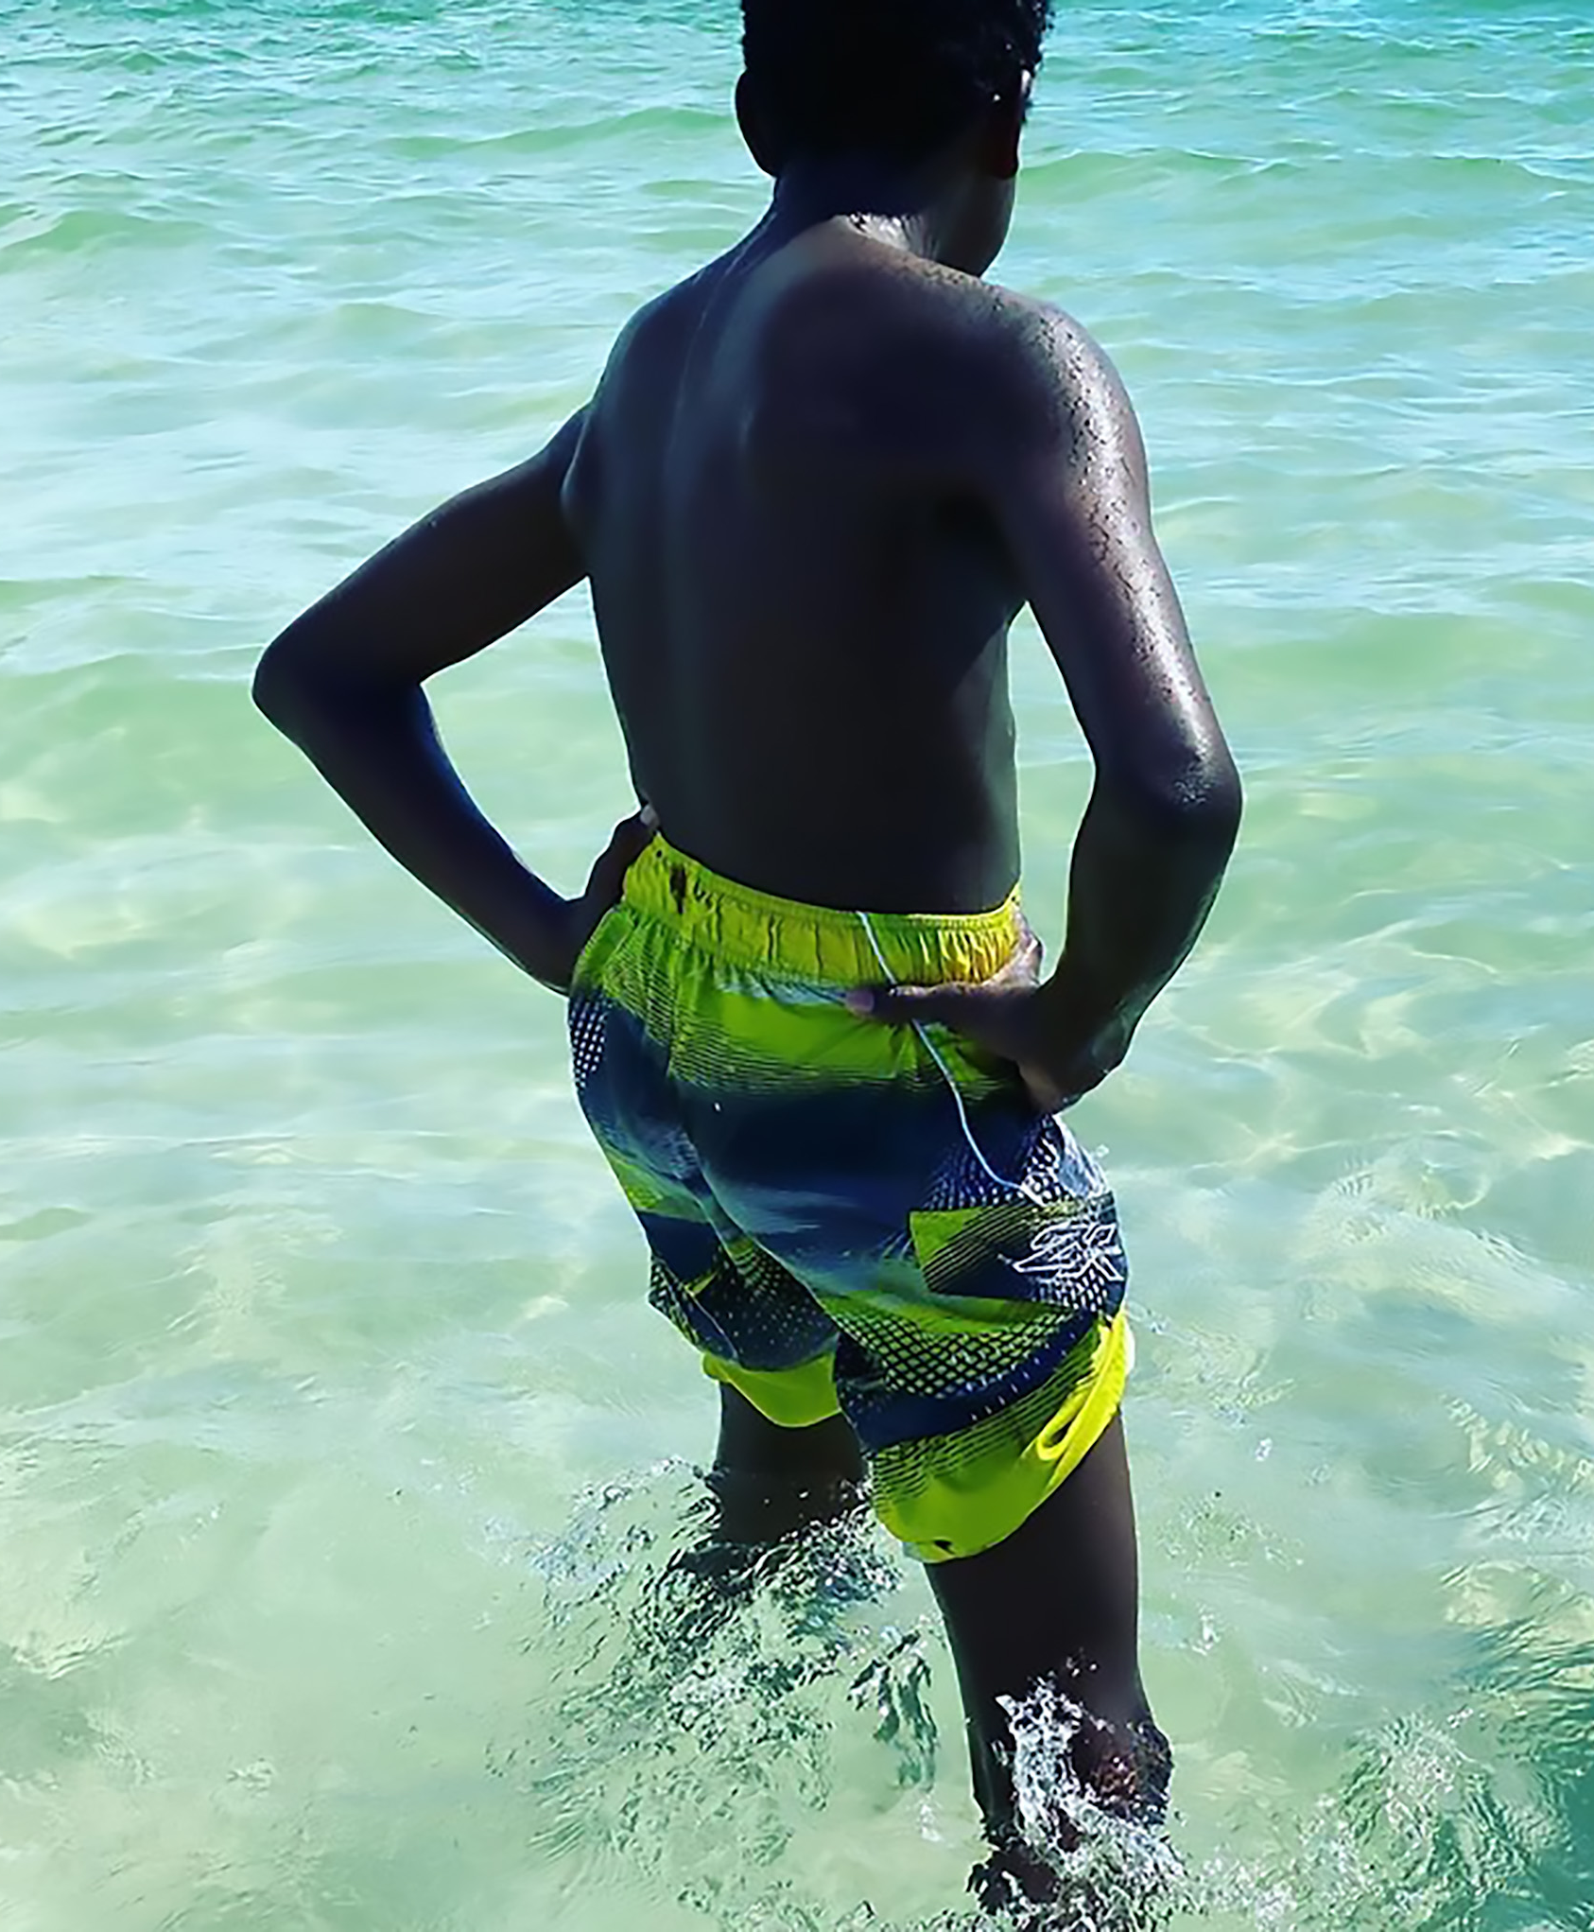
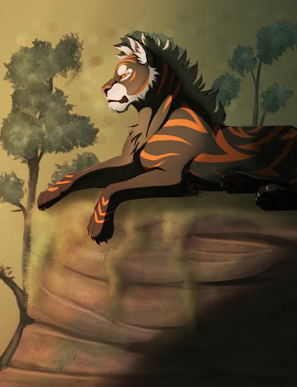
Digital Art & Design 1 & Creative Photography 1 Grades 7 & 8 (that have taken Visual Art 1)
Explore the fundamental concepts, terminology, techniques, and applications of digital imaging to create original work.
Produce digital still and/or animated images.
Use computers, digital cameras, photo editing software, drawing and painting software, graphic tablets, printers, and more!
Notes:
Black
All access elective uses suffix A and magnet course has suffix F.

Slide 18
Teacher Assistant (TA)
What is the Teacher Assistant course?
Teacher Assistants are assigned to grade level offices to learn about how to run an office.
What will I do as a TA?
Help with administrative tasks such as filing and attendance.
Help with school event preparations
Give tours to new students
Students will gain experience in how an office runs
Deliver items/help offices coordinate with classrooms

Slide 19
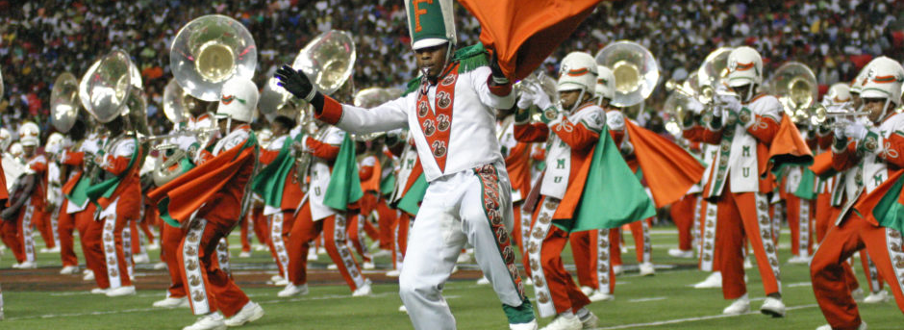
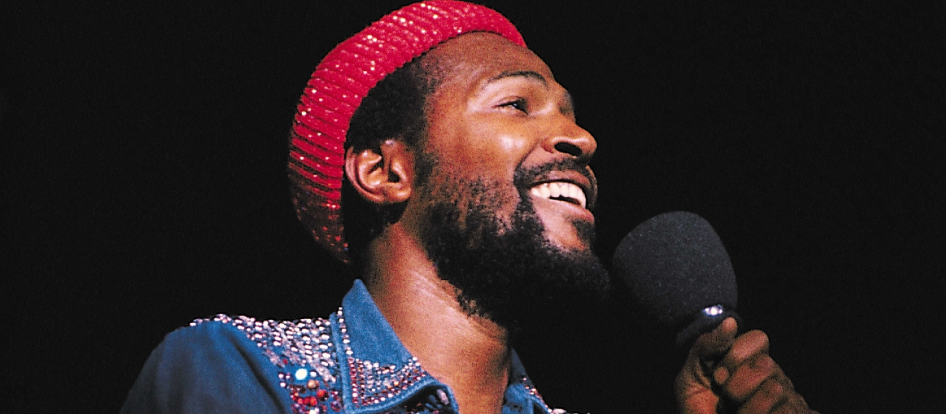
Understanding Music
Discover new music from around the world
Learn how to listen to familiar music in new ways
Explore new instruments
Study the fundamental aspects of music performance and creation
Notes:
King, Littlepage, and/or Nuetzel

Slide 20
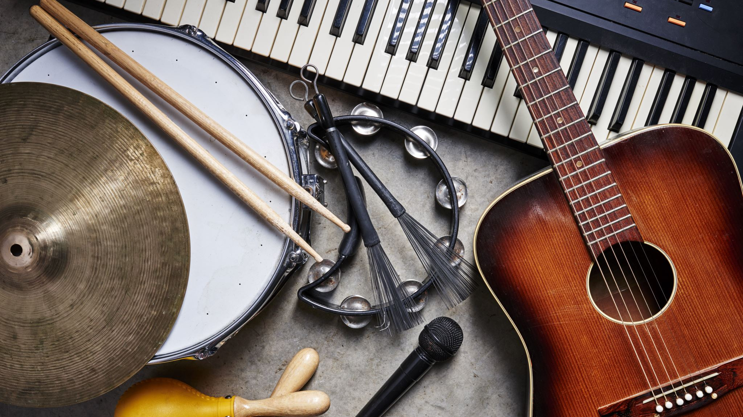
Music Technology
The two main goals of this course are:
To better understand music in general, including listening skills, theory, and history
To gain understanding of producing music from the technology and creation side.
Notes:
Littlepage

Slide 21
Journalism 1 Grades 6, 7 & 8
In this class, students will learn the foundations of how to consume a new story, brainstorm for their own version, research, write and edit and produce a news story. Their work will be published if they so wish on the department website.
Notes:
Evans
All access elective with suffix A is separate classes from magnet with suffix F.

Slide 22
Tasks: Complete Forms Questionnaire
Please use the links found on our school’s homepage gojhop.com or the links below. QR codes are on the next slides.
CGS Scholars: Course Selection 2023-2024 Link
Magnet Scholars: Course Selection 2023-2024 Link
Traditional Scholars: Course Selection 2023-2024 Link

Slide 23
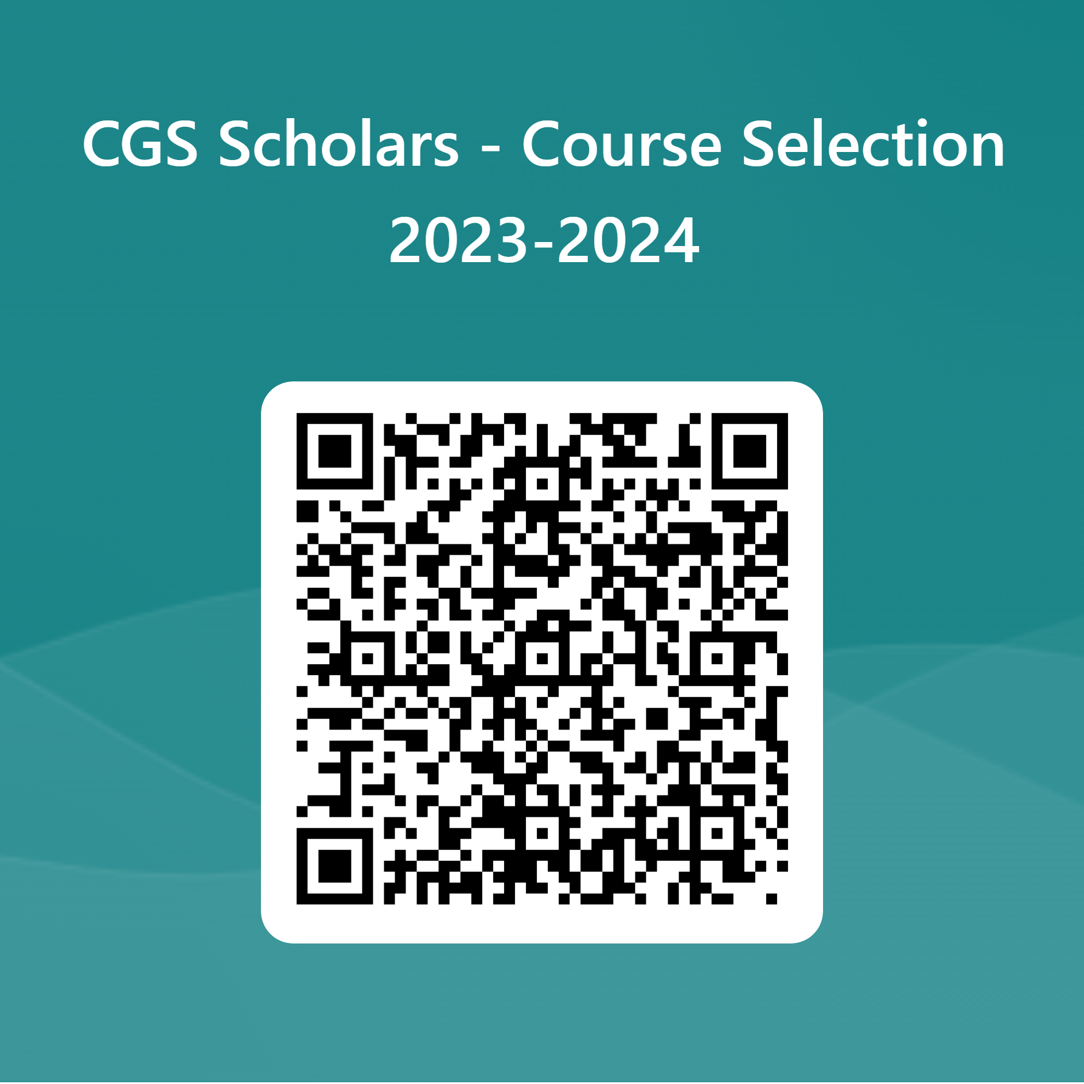
CGS Scholars
Please use the links found on our school’s homepage gojhop.com or the link below. QR code for CGS Survey is included on this slide.
CGS Scholars: Course Selection 2023-2024 Link

Slide 24
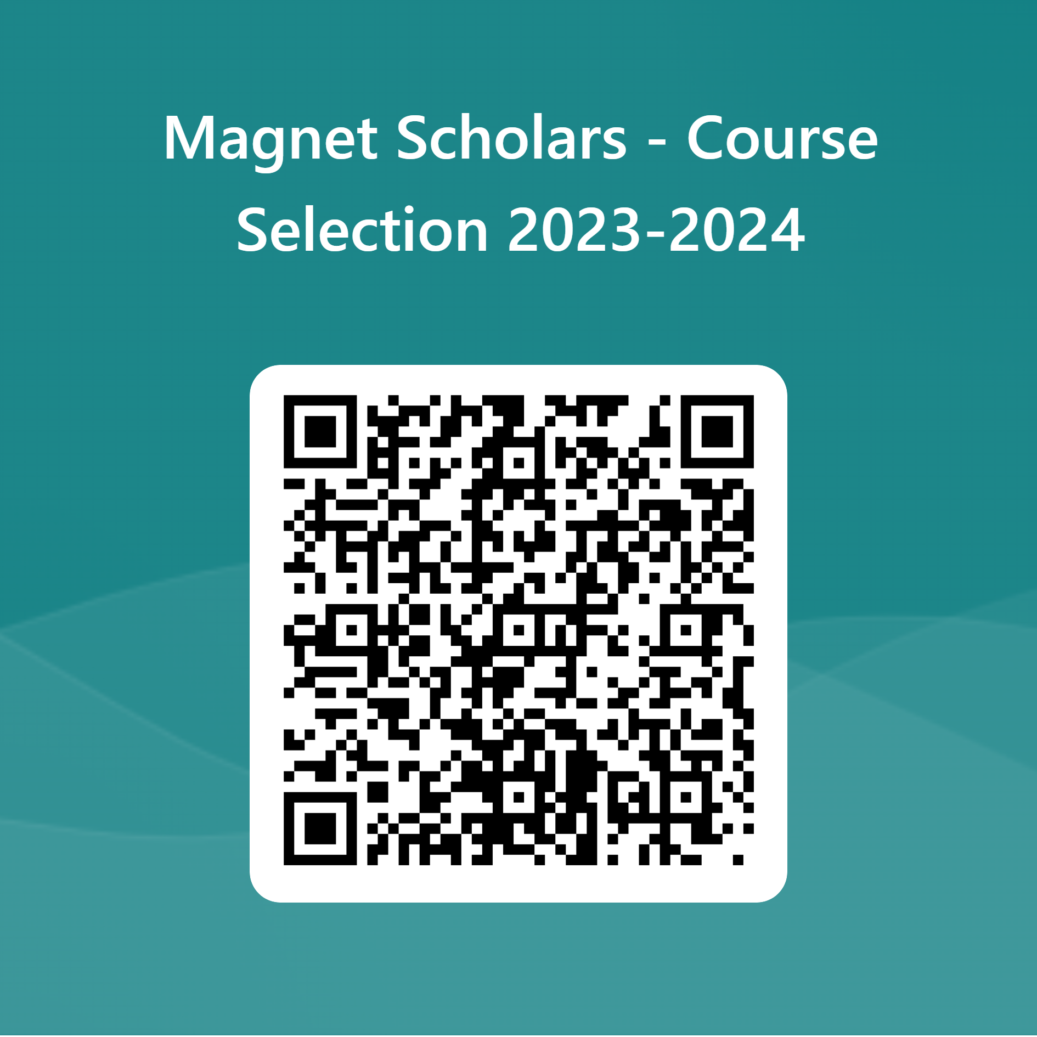
Magnet Scholars
Please use the links found on our school’s homepage gojhop.com or the link below. QR code for Magnet Survey is included on this slide.
Magnet Scholars: Course Selection 2023-2024 Link

Slide 25
Traditional Scholars
Please use the links found on our school’s homepage gojhop.com or the link below. QR code for Traditional Survey is included on this slide.
Traditional Scholars: Course Selection 2023-2024 Link

